Slide 1
4.0 Mini-Intro to Roles/Features
What are roles and features?

Slide 2
Role
Role is a type of server that a computer can assume. These include
Web roles
File server roles
Communication server roles
Management roles
and more

Slide 3
Feature
An additional, smaller capability that you can install. These include:
Bitlocker encryption
Telnet Server and Client
RIP Listener
Powershell
Unlike a role, a feature does not drastically change the functionality of a computer within a network.

Slide 4
What should I be concerned with?
Computers should only have roles/features that they need installed.
Examples:
Standard workstations should not have web server roles installed, as that exposes the system to the public.
A computer that doesn’t use telnet should remove telnet, since keeping it just means another method for hackers to compromise the system.

Slide 5
How to manage them?
Windows non-server versions (including 10)
appwiz.cpl
Windows server versions (including 2016 and 2019)
Use previous appwiz.cpl method OR
Use server manager, go under “Manage” and look for the “Add/Remove Roles and Features”
To find server manager, you can use windows search

Slide 6
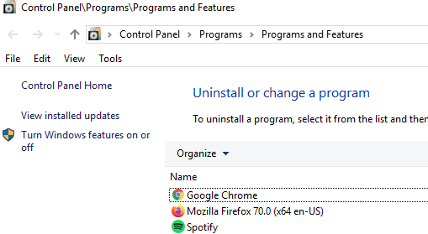

Slide 7
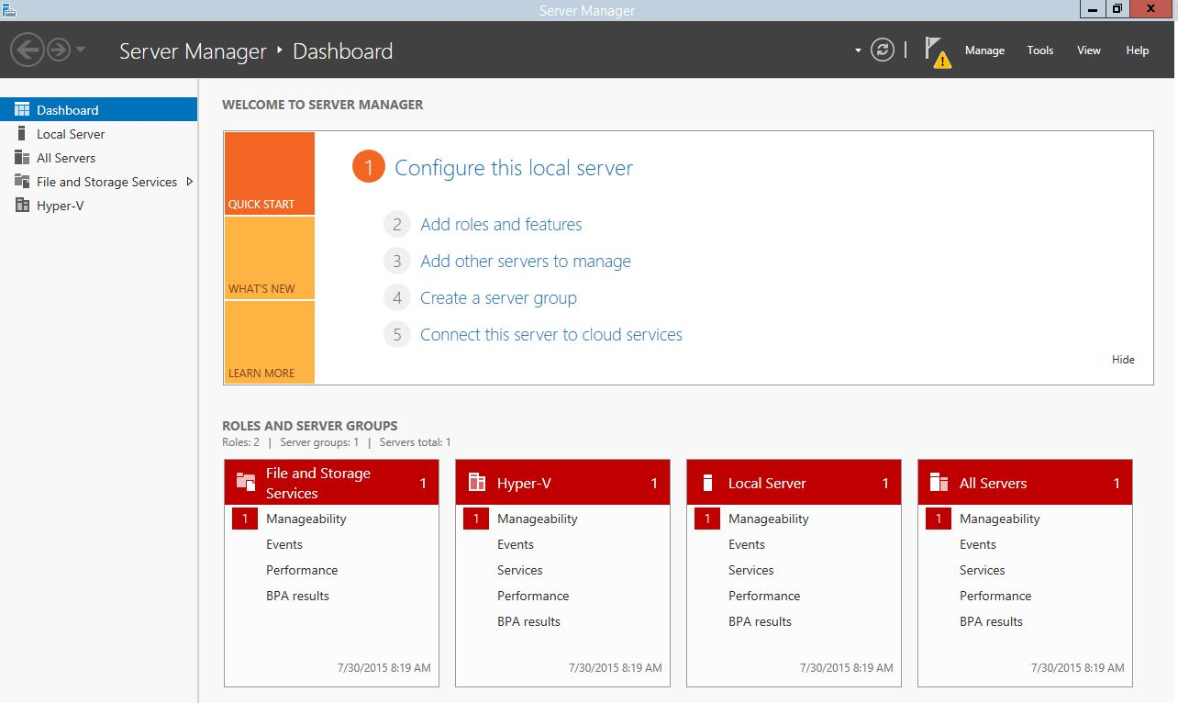

Slide 8
Role Management (Server)
Role management in server versions is a tad bit fancier
Process
Select role-based or feature-based installation
Select computer you would like to manage (your own)
Choose the roles/features you want added/removed
There are two different windows for adding and removing roles/features
First two steps of the process outlined above are automatically set for you, so you just need to click the Next button

Slide 9
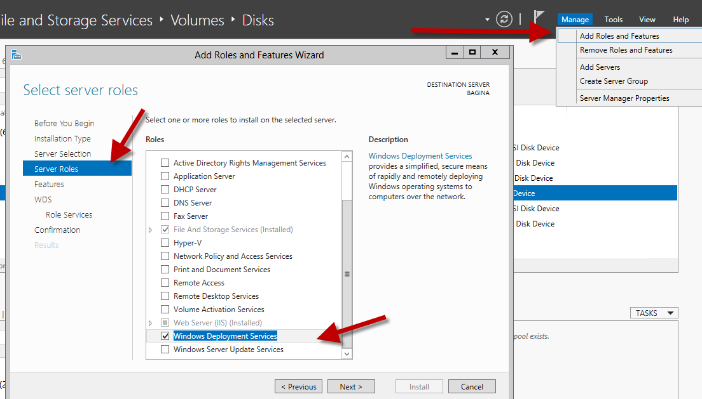
Features configuration is right after roles
Depending on the role you pick, you might have to do additional steps (as shown under WDS)

Slide 10
Note on services
Uninstalling roles/features will also remove any services that came with the installation
Examples ([role] → [respective service]):
RIP Listener feature → Rip Listener service
Telnet Server feature → Telnet service
Internet Information Services (World Wide Web Services) role → World Wide Web Publishing Service
Internet Information Services (FTP Server) role → Microsoft FTP Service

Slide 11
Difference between configuring service and role
Disabling and stopping a service will effectively stop communications and functionalities that the service provides
However, this is a temporary action - someone can re enable the service.
Uninstalling the role/feature that the service came with will ensure that the service is not accidentally/intentionally going to be turned on
Roles/features management requires administrative privileges, whereas services management doesn’t always

